Slide 1
CSE 3412 Project Proposal & Benchmark Study
Sidratul Muntaha
LECTURER, DEPT. OF CSE, UIU
ACKNOWLEDGED: SAMIN SHARAF SOMIK

Slide 2
Content
You are required to present a project proposal from each group on the next lab. It must have the following sections.
A short description of your project.
Motivation (Why do you want to build this project?)
Benchmark study (Discussion on existing similar systems and their limitations)
Project Scope and Features
Tools/Languages/APIs/Frameworks/Programs to be used
Make each section comprehensive to get better marks.

Slide 3
Do’s and Don’ts
Two members from each group will give the presentation.
The other members will answer questions.
Duration of each presentation will be 5 minute. Each of the two members will get equal amount of time (2.5min +2.5min).
The preferred language of the presentation will be English.
Each group member needs to attend the class to get marks.
Do not just read out the slide

Slide 4
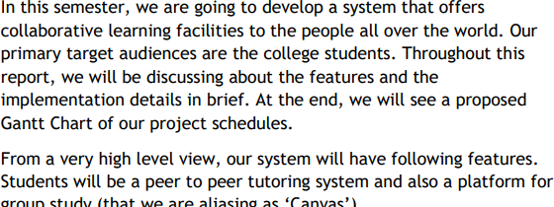
Short Description

Slide 5
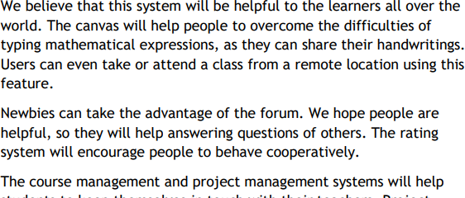
Motivation

Slide 6
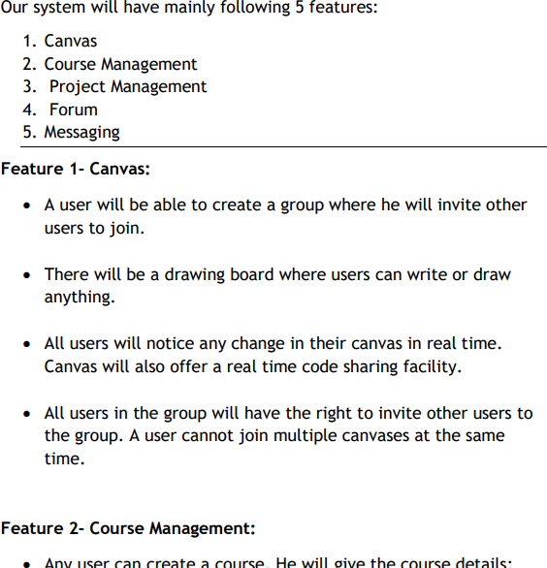
Scope & Features

Slide 7
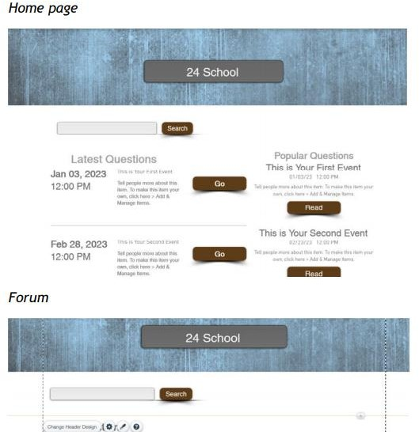
Scope & Features (Bonus)
Prototyping tools such as Pencil (https://pencil.evolus.vn/) can be used.

Slide 8
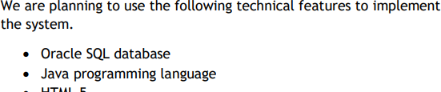
Tools

Slide 9
Benchmark Analysis

Slide 10
Your task is to create a presentation comparing n number of popular information systems (Softwares/Services) against your project in the same market.
Where, n = number of team members in your group

Slide 11
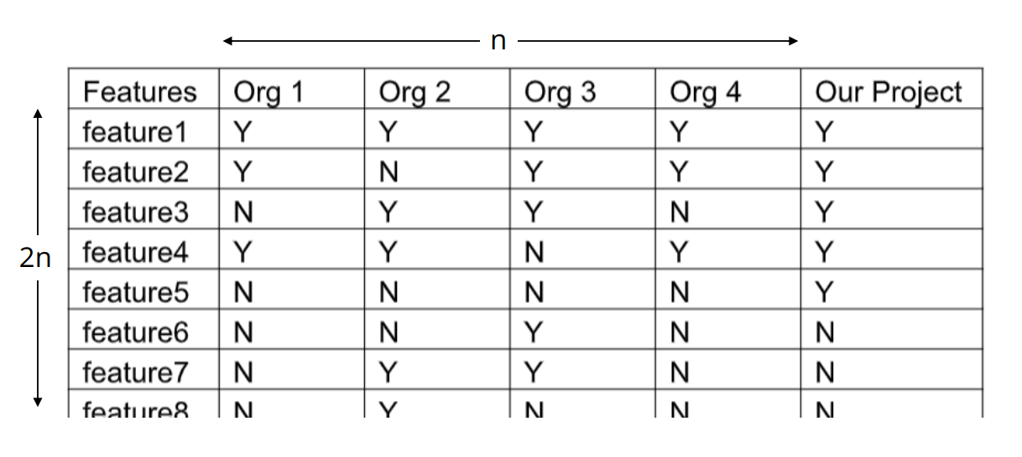
Note down what features are offered in each of the other softwares/services, and what features you are offering in a chart. The chart should have not less than 2n features for comparison (where n = number of team members in your group). I.e. for a group of 6, the number of features to compare will be 2 x 6 = 12.

Slide 12
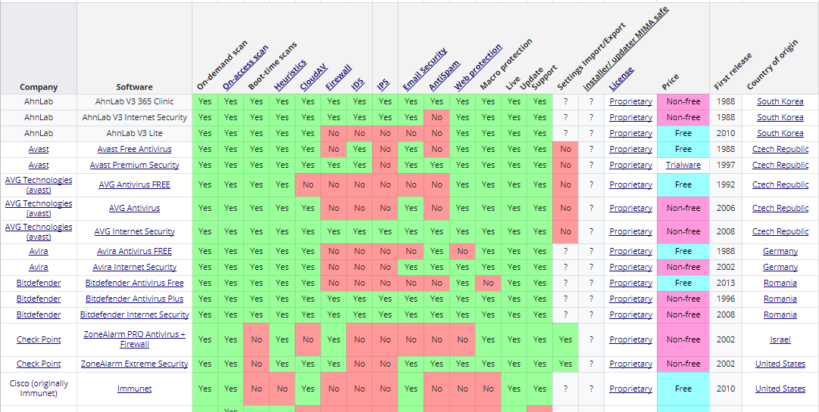
Benchmark Chart Example
Benchmark for Antivirus software (Source: Wiki)

Slide 13
Alongside the 2n functional features of the service, the following points may be considered:
Pricing policy
Example: free/one time/monthly/Pay-as-you-go
Customer base size
Market Value/ Stock price
Country

Slide 14
In your presentation, you possibly need to explain the following scenarios:
Suppose, Organization 2 does not support feature2 but your project does.
Explain how that puts organization 2 in a weak spot. Make sure to support your claim with evidence and argument.
Suppose, Org 3 supports feature5 and feature6 which your project does not.
Discuss how they put them in a strong position.
Also discuss why you thought the feature should not be implemented in your project (eg. the service of Org 3 is more expensive or not so important to your target audience.)
Suppose, feature 5 is unique to your project.
Discuss why you think it will create credibility of your project to the consumers.

